Slide 1
Finding Empirical Research
Articles in ERIC
Robin Ewing
St. Cloud State University Library

Slide 2
Table of Contents*
What are empirical research articles?
Why do I need to find empirical research articles?
What is ERIC?
How do I access ERIC?
Finding empirical research articles in ERIC
Tell ERIC to find empirical research articles
Bonus: How to read an empirical research article

Slide 3
What are empirical research articles?
Empirical research articles report on “any scientific study (qualitative or quantitative) in which some sort of evidence is obtained through methods that rely on the senses (i.e., direct or indirect observation)” (Empirical Research, 2010).

Slide 4
Why do I need to find empirical research articles?
The Doctoral Dissertation Handbook for Higher Education Administration states, “It is particularly important that the literature review is built primarily around literature that reports the results of empirical studies, although it is also important to refer to foundational and conceptual pieces about the topic” (2014, p. 46).
Other School of Education graduate programs have similar requirements.

Slide 5
What is ERIC?
The Education Resources Information Center, better known as ERIC, is the primary database supporting research in all areas of education, including psychology, administration, and library science. The content in ERIC is compiled by the Institute of Education Sciences (IES) of the U.S. Department of Education. While not the only resource for research articles on education topics, ERIC is the place to start.

Slide 6
What is ERIC?
While you can access ERIC online at http://www.eric.ed.gov/, the SCSU library provides access to ERIC through ProQuest. We pay for this version because it gives researchers (That’s you!) better access to information and includes FindIt, our tool for helping you find the full-text of articles.

Slide 7
How do I access ERIC?
Go to the SCSU Library’s homepage at http://lrts.stcloudstate.edu/library/
Select the Databases A-Z link
Select ERIC from the list
If you are off-campus, you will be asked to log in with your StarID and password
You are now ready to search in ERIC

Slide 8
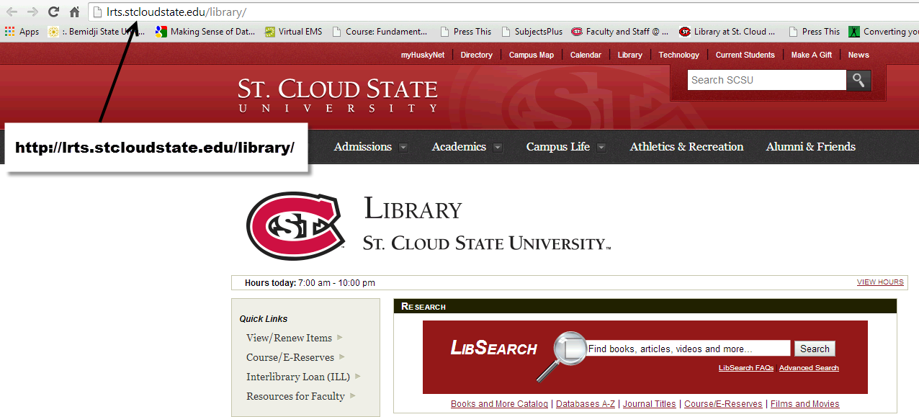
Go to the SCSU Library’s homepage at http://lrts.stcloudstate.edu/library/

Slide 9
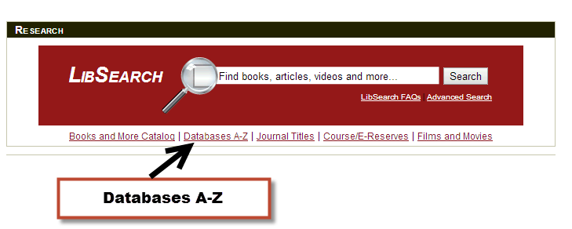
Select the Databases A-Z link

Slide 10
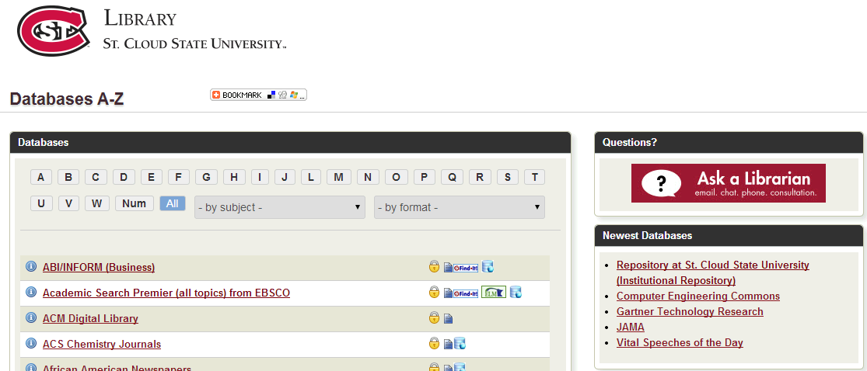
Databases A-Z
The Databases A-Z page lists all of the databases that SCSU provides for students.

Slide 11
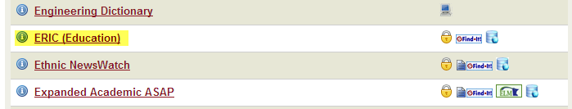
Select ERIC from the list

Slide 12
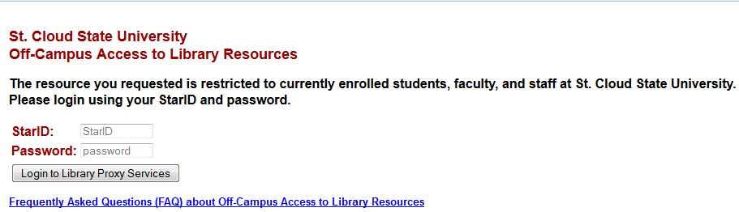
Off-campus users, log in with your StarID and password

Slide 13
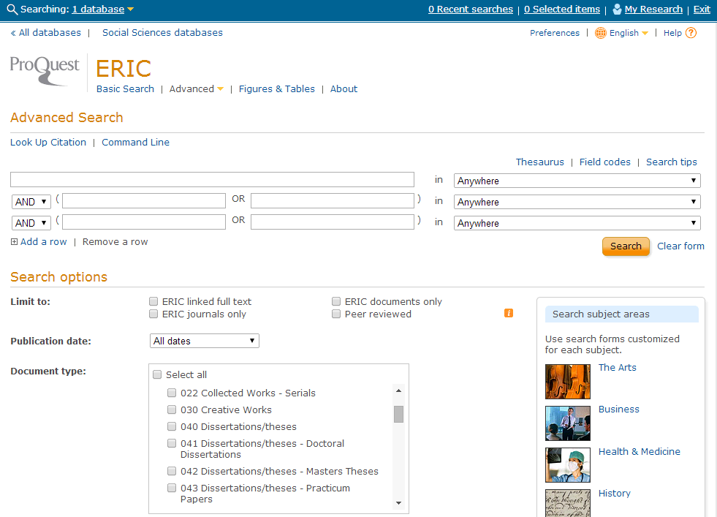
ERIC Search Screen

Slide 14
Finding empirical research articles in ERIC
One way to find empirical research articles is to search as you normally do and then examine the article abstracts for words like “a study, an observation, number of participants, survey, questionnaire, or interview.” These terms are frequently used to describe empirical research (Cal Poly Pomona FAQ, 2013).
A better way to find empirical research articles in ERIC is to tell the database that’s the type of articles you want to find.

Slide 15
Tell ERIC to find empirical research articles
Access ERIC
Enter your search terms
Limit to peer reviewed articles
Select document type 143 Reports – Research
Click search and start reading!
Example article

Slide 16
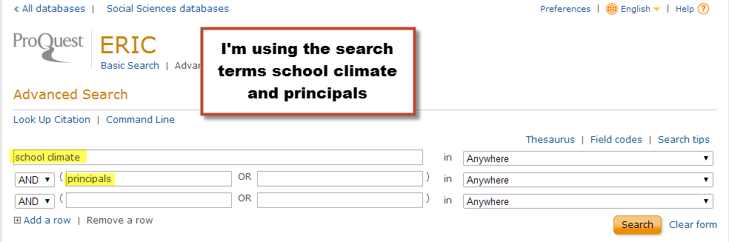
Enter your search terms

Slide 17
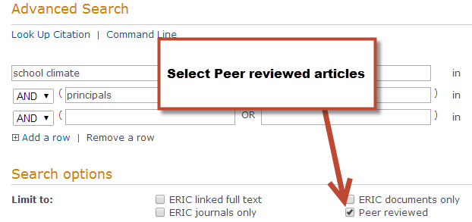
Limit to peer reviewed articles

Slide 18
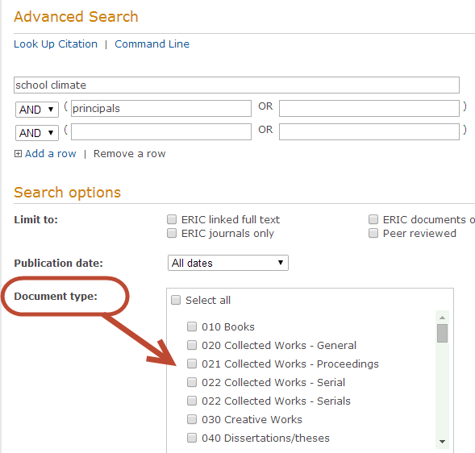
Document Type

Slide 19
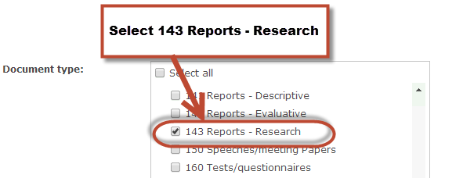
Select document type 143 Reports - Research

Slide 20
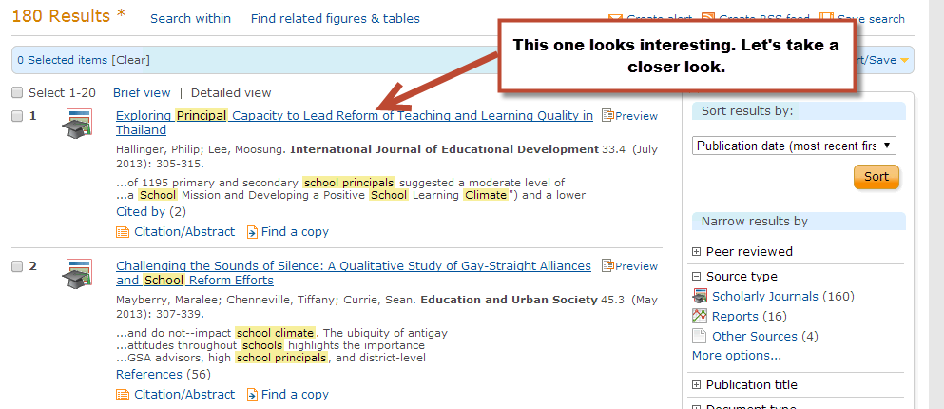
Click search and start reading!

Slide 21
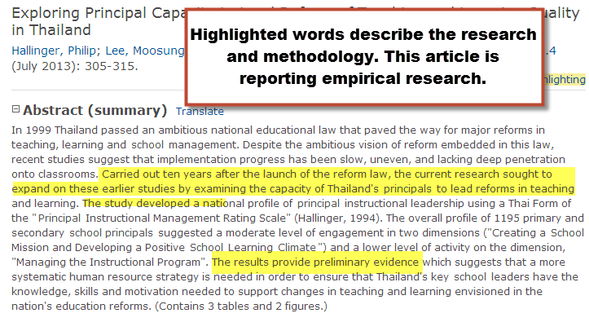
Example Article

Slide 22
How to read an empirical research article

Slide 23
References
Cal Poly Pomona University Library. (2013). FAQ: My instructor said that I needed to find "Empirical" articles. What should I do? Retrieved from http://libanswers.library.csupomona.edu/a.php?qid=33985
Empirical research. (2010). In Dictionary of nursing theory and research. Retrieved from http://search.credoreference.com.libproxy.stcloudstate.edu/content/entry/spnurthres/empirical_research/0
Higher Education Administration, St. Cloud State University. (2014). Doctoral dissertation manual. Retrieved from http://www.stcloudstate.edu/hied/documents/DissertationHandbook2014.pdf
Institute of Education Sciences. (2014). ERIC. Retrieved from http://eric.ed.gov/
Morgankenneth12. (2010, December 26). How to read an empirical research article [video file]. Retrieved from https://www.youtube.com/watch?v=legYfGC46y4

Slide 24
Questions?
Please contact:
Robin Ewing, School of Education Liaison
St. Cloud State University Library
rlewing@stcloudstate.edu
(320) 308-2093

