Slide 1
The Library Links Feature of
Google Scholar
Robin Ewing
St. Cloud State University Library

Slide 2
Table of Contents*
What is Google Scholar?
How do I access Google Scholar?
I’ve got a list of articles, now what?
This article costs $30?
What are library links in Google Scholar?
How do I set up a library link?
Bonus video: Using Google Scholar

Slide 3
What is Google Scholar?
Google Scholar allows you to search the Web for peer-reviewed papers, theses, books, abstracts, and articles available from academic publishers, professional societies, preprint repositories, universities, and other scholarly organizations.
Google Scholar is particularly good with interdisciplinary topics.

Slide 4
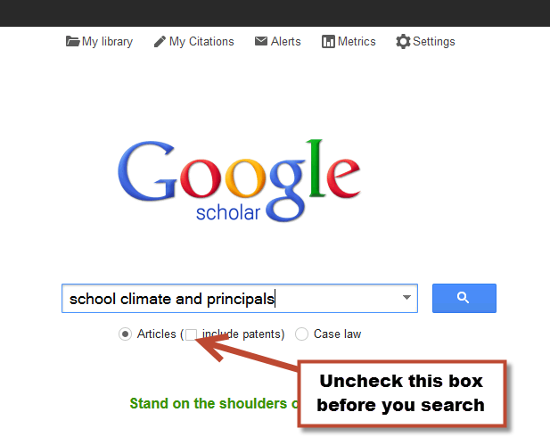
How do I access Google Scholar?
Go to http://scholar.google.com/
Enter your search terms (uncheck the box for patents)

Slide 5
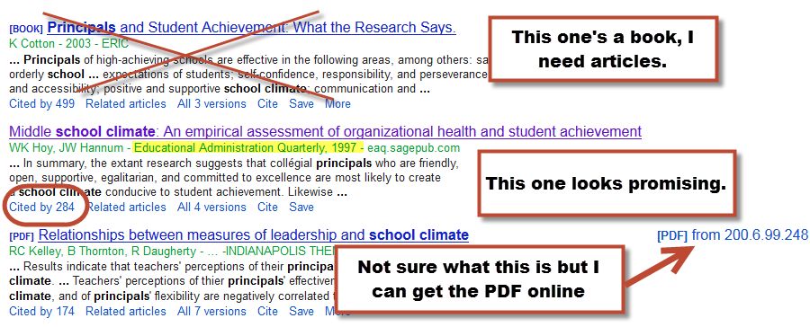
I’ve got a list of articles, now what?
Click on the citation for the article you want

Slide 6
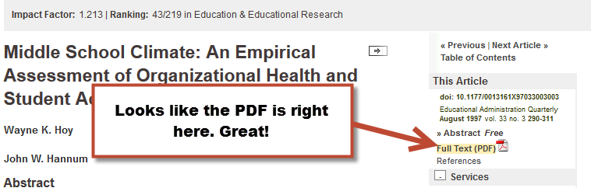
This article costs $30?

Slide 7
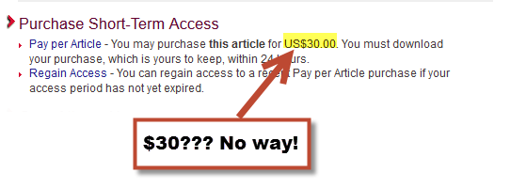
This article costs $30?

Slide 8
What are library links in Google Scholar?
Library links allow SCSU library users to connect the citations in Google Scholar to our resources via FindIt.
FindIt is a tool that searches our databases for the article you’re looking for. If we don’t have it, you can request it through Interlibrary Loan (ILL).

Slide 9
How do I set up a library link?
Go to Google Scholar
Select Settings
Select Library Links
Enter St. Cloud State
Select St. Cloud State University and hit save
Redo your search
Let’s look at that article again
Click the FindIt link

Slide 10
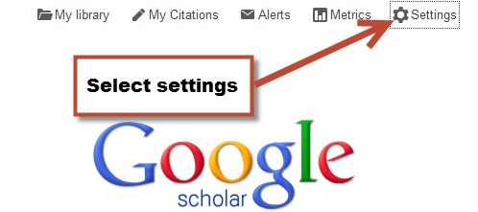
Select Settings

Slide 11
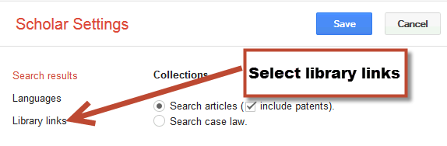
Select Library Links

Slide 12
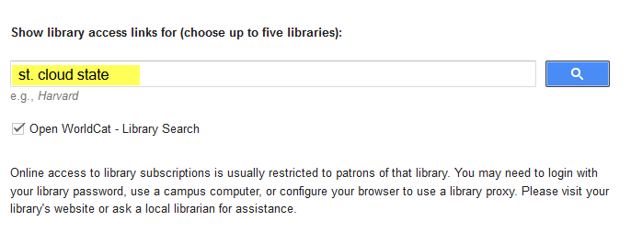
Enter St. Cloud State

Slide 13
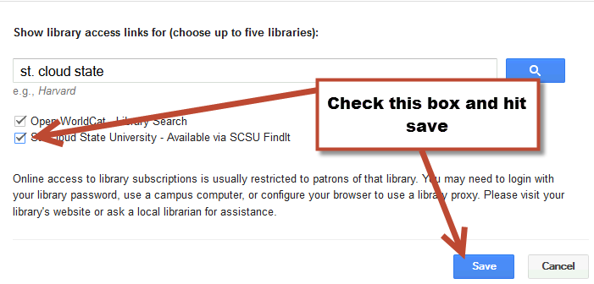
Select St. Cloud State University and hit save

Slide 14
Redo your search

Slide 15
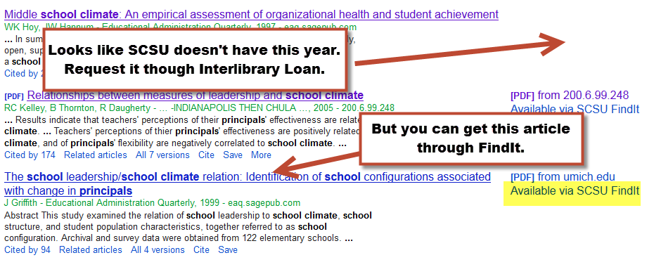
Let’s look at that article again

Slide 16
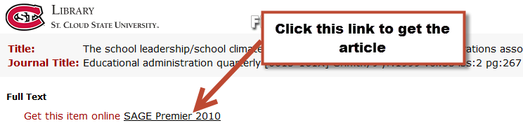
Click the FindIt link

Slide 17
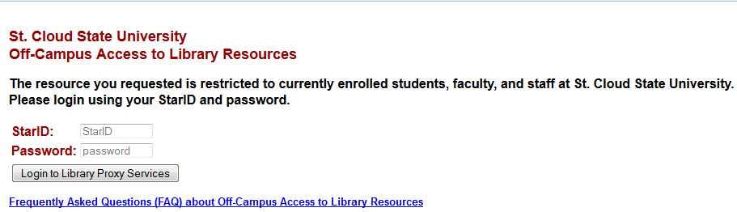
Off-campus users, log in with your StarID and password

Slide 18
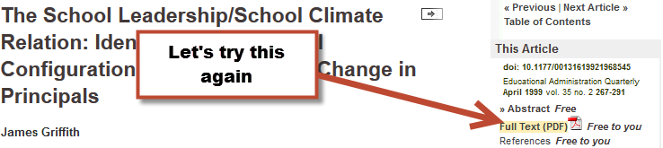
Click the FindIt link

Slide 19
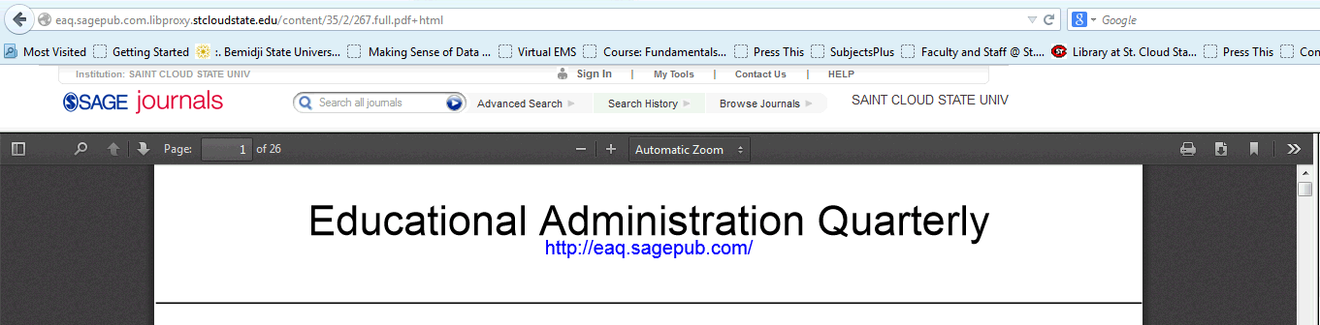
Success!

Slide 20
Using Google Scholar

Slide 21
Questions?
Please contact:
Robin Ewing, School of Education Liaison
St. Cloud State University Library
rlewing@stcloudstate.edu
(320) 308-2093

