Slide 1
Cited By Feature in ERIC
Robin Ewing
St. Cloud State University Library

Slide 2
Table of Contents*
What is ERIC?
How do I access ERIC?
I found a great article, how do I find more?
Going backward in time
How do I find new articles?
What is “Cited by”?
Going forward in time

Slide 3
What is ERIC?
The Education Resources Information Center, better known as ERIC, is the primary database supporting research in all areas of education, including psychology, administration, and library science. The content in ERIC is compiled by the Institute of Education Sciences (IES) of the U.S. Department of Education. While not the only resource for research articles on education topics, ERIC is the place to start.

Slide 4
What is ERIC?
While you can access ERIC online at http://www.eric.ed.gov/, the SCSU library provides access to ERIC through ProQuest. We pay for this version because it gives researchers (That’s you!) better access to information and includes FindIt, our tool for helping you find the full-text of articles.

Slide 5
How do I access ERIC?
Go to the SCSU Library’s homepage at http://lrts.stcloudstate.edu/library/
Select the Databases A-Z link
Select ERIC from the list
If you are off-campus, you will be asked to log in with your StarID and password
You are now ready to search in ERIC

Slide 6
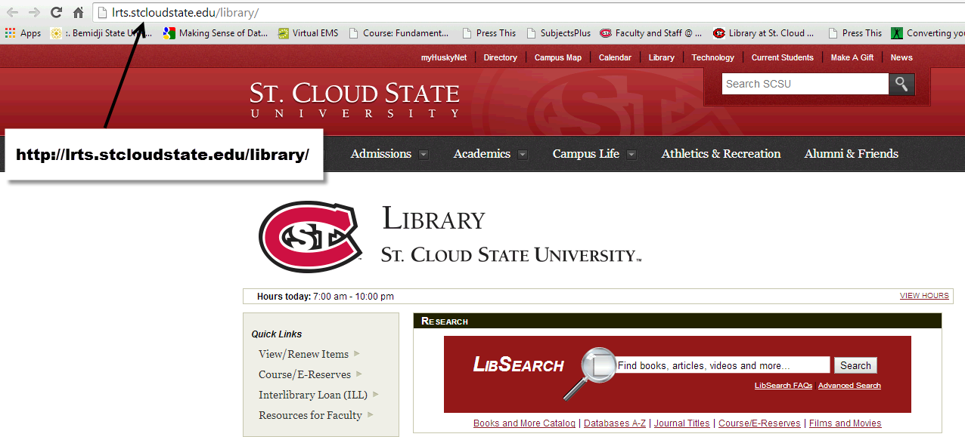
Go to the SCSU Library’s homepage at http://lrts.stcloudstate.edu/library/

Slide 7
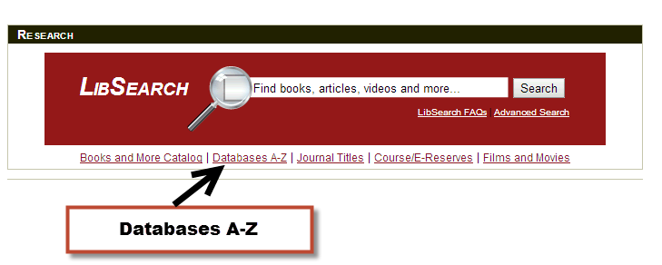
Select the Databases A-Z link

Slide 8
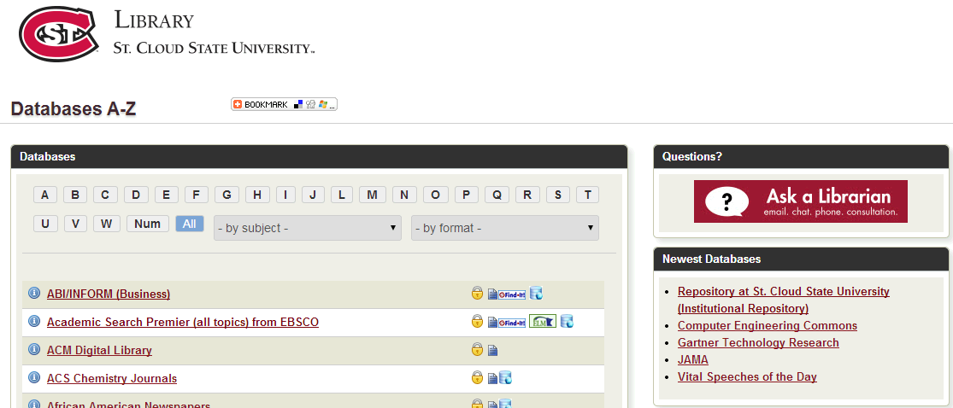
Databases A-Z
The Databases A-Z page lists all of the databases that SCSU provides for students.

Slide 9
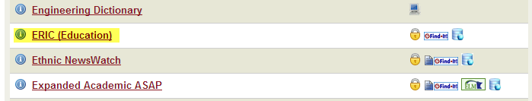
Select ERIC from the list

Slide 10
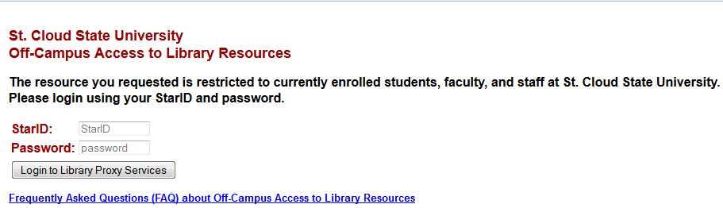
Off-campus users, log in with your StarID and password

Slide 11
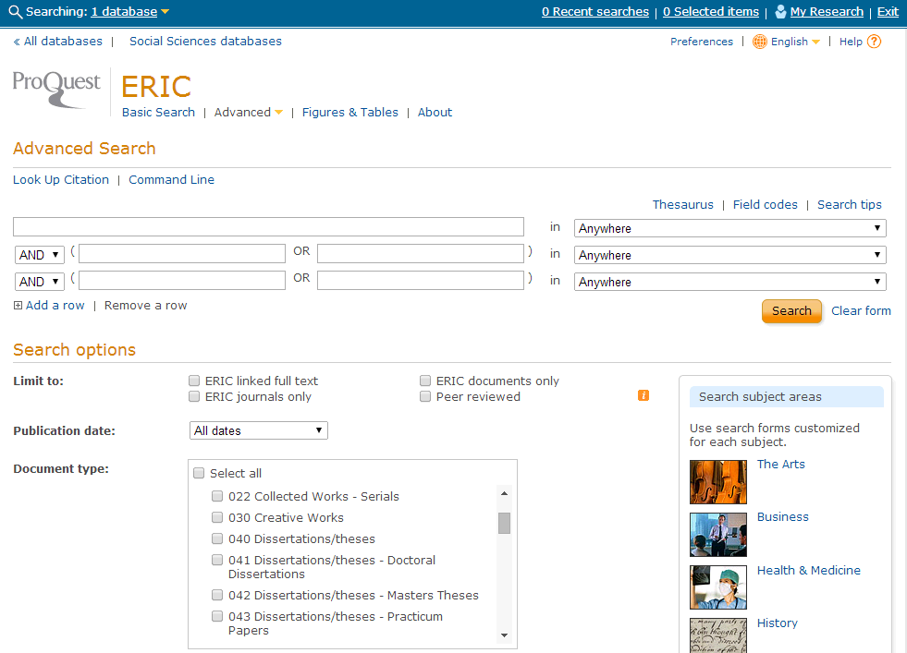
ERIC Search Screen

Slide 12
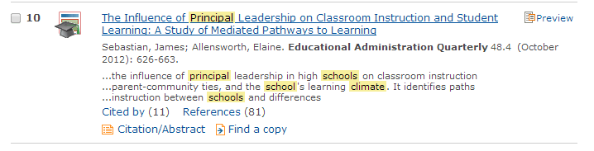
I found a great article, how do I find more?
My thesis discusses the affect principals have on school climate. I searched and found the following article.

Slide 13
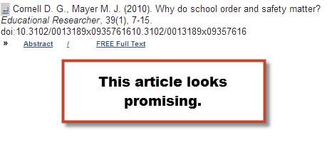
I found a great article, how do I find more?
I read the article and I want to find some of the research the author cites.

Slide 14
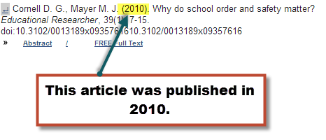
Going backward in time
The article I want to find was published in 2010, which is two years before the first article I read.

Slide 15
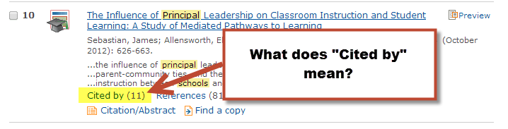
How do I find new articles?
Go back to your search results in ERIC. Pro tip: Keep this tab open!
Look at the entry for your original article.

Slide 16
What is “Cited by”?
The “Cited by” link in ERIC provides a list of information sources that have cited the original article. A higher number means more people have cited and is an indication that the original article has been read widely and considered important.
Keep in mind that some time has to elapse for scholars to read the article and integrate it into their publications. You’re not likely to see many 2014 articles cited by anyone else yet.

Slide 17
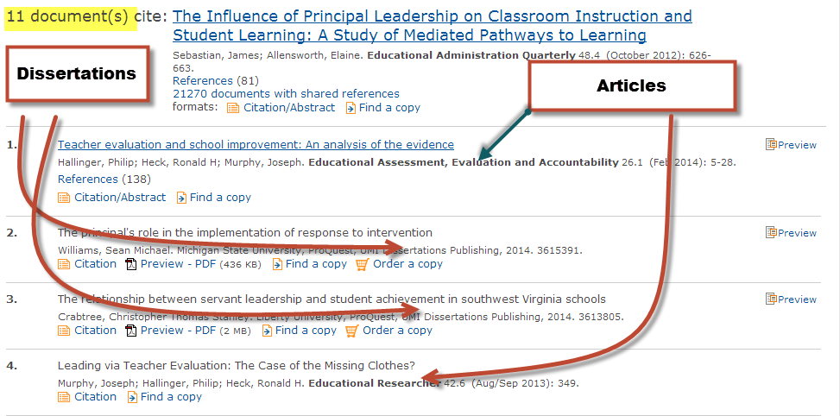
Going forward in time
Select the “Cited by” link to get the citations that have used the first article.

Slide 18
Going forward in time
In this example, most of the references in the “Cited by” list are for dissertations. This is not surprising.
Scholars completing their theses and dissertations are expected to be aware of and acknowledge the latest research on their topics.
The Doctoral Dissertation Handbook for Higher Education Administration states, “Sources are of high research quality and scholarly nature; sources include latest publications” (2014, p. 53).

Slide 19
Questions?
Please contact:
Robin Ewing, School of Education Liaison
St. Cloud State University Library
rlewing@stcloudstate.edu
(320) 308-2093

